Slide 1
Communities of Earning
Empowering communities one KidsCoin dollar at a time
Social Enterprise Forum 2017

Slide 2
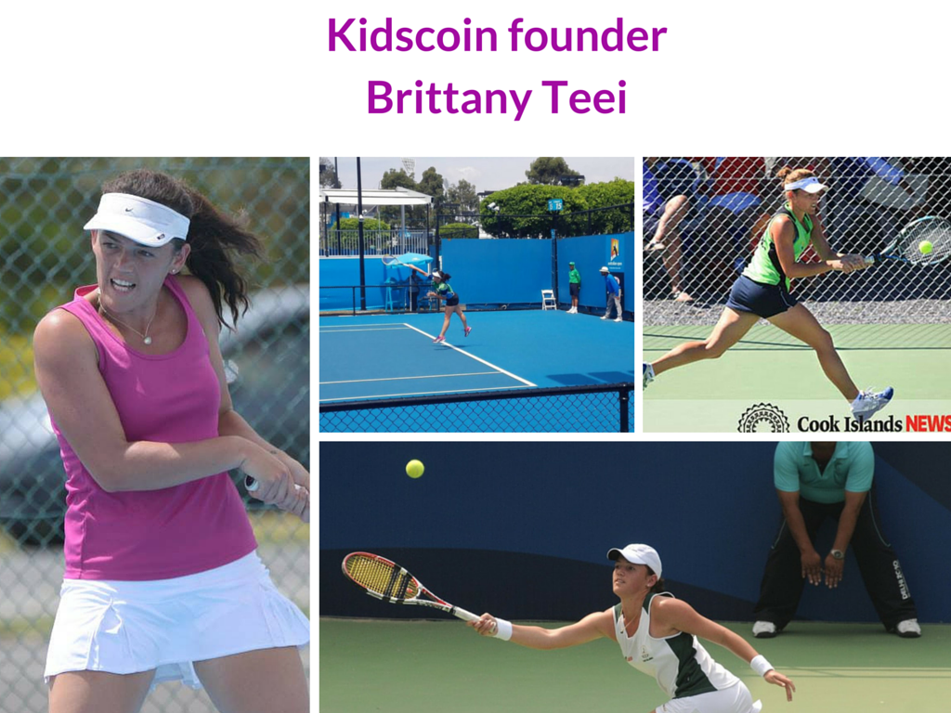

Slide 3
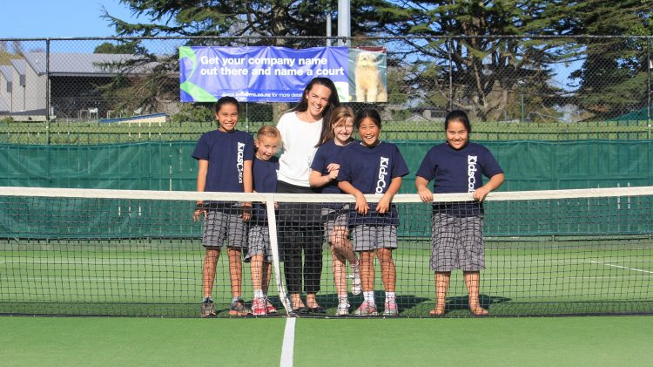
Cross-Pollination

Slide 5
HOW IT WORKS
Earn
Manage
Shop
Online Learning
Online Banking
E-Commerce for Kids!

Slide 6
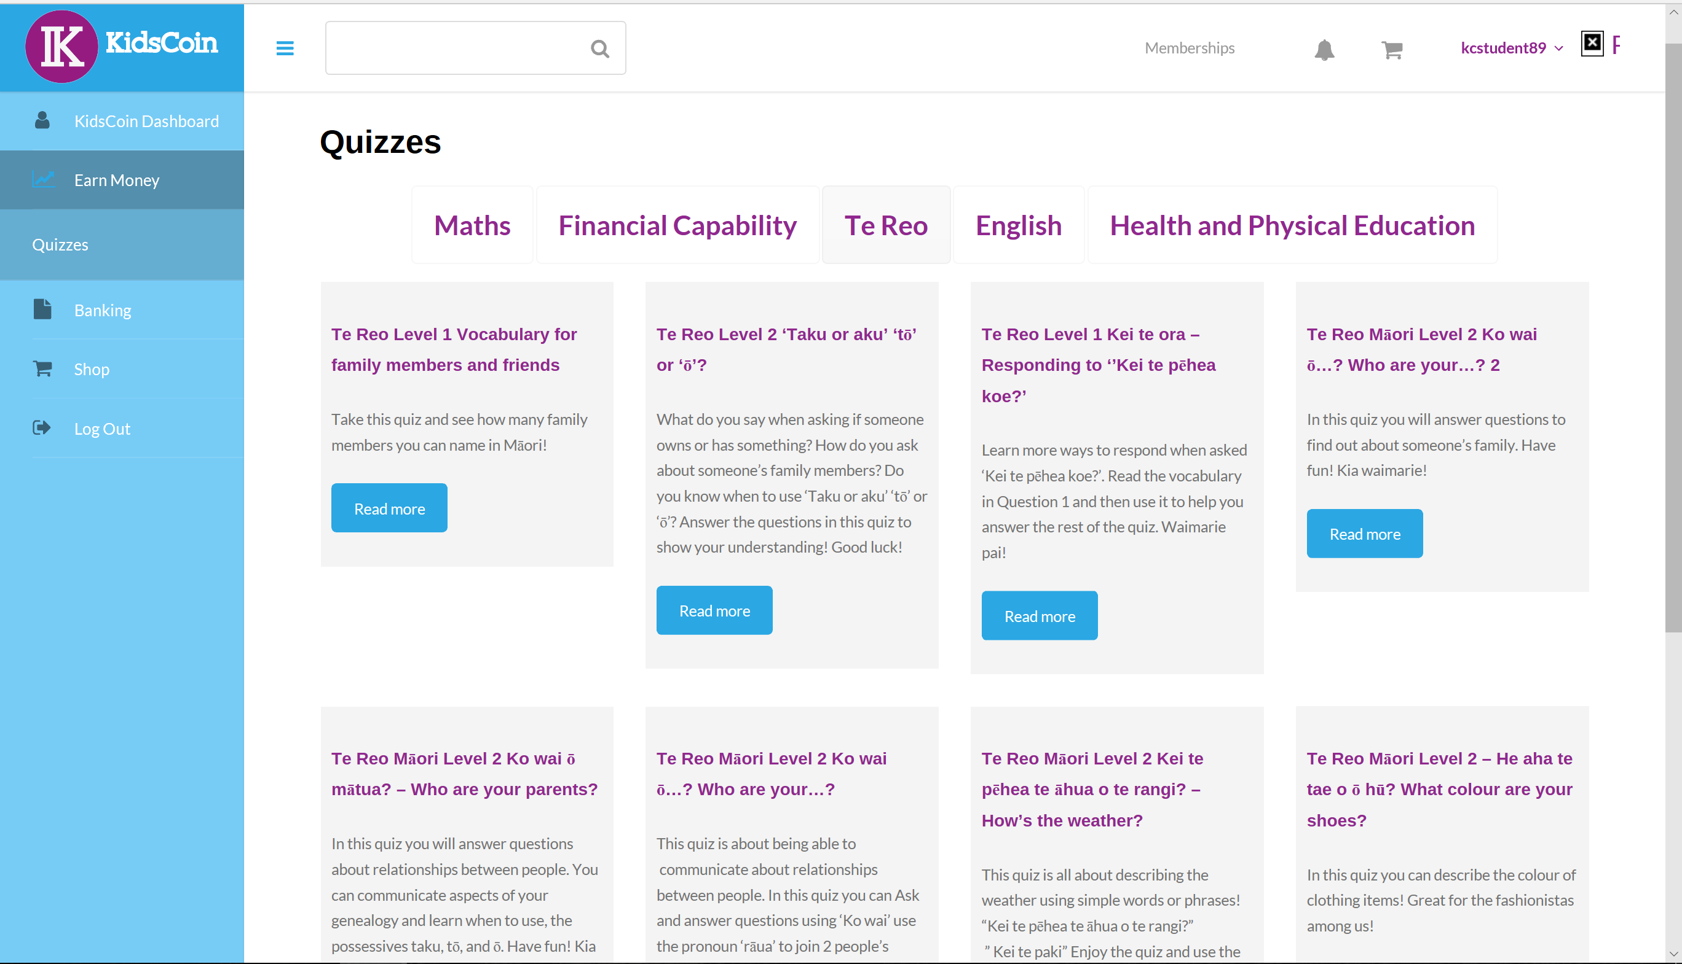

Slide 7
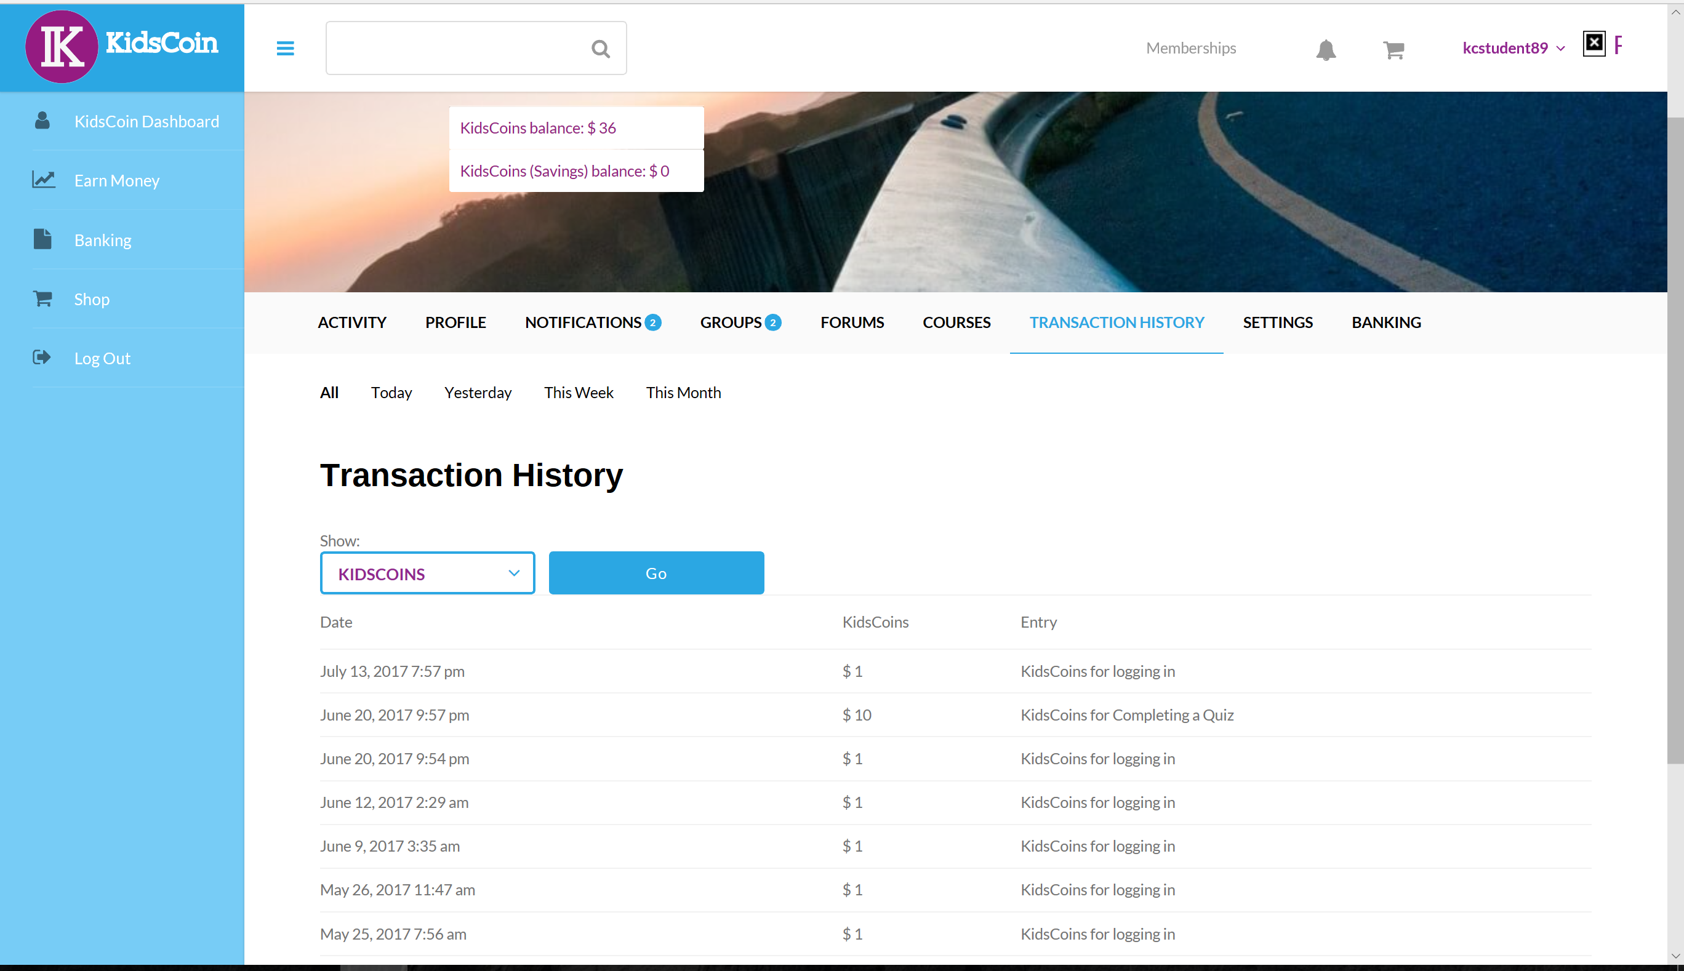

Slide 8
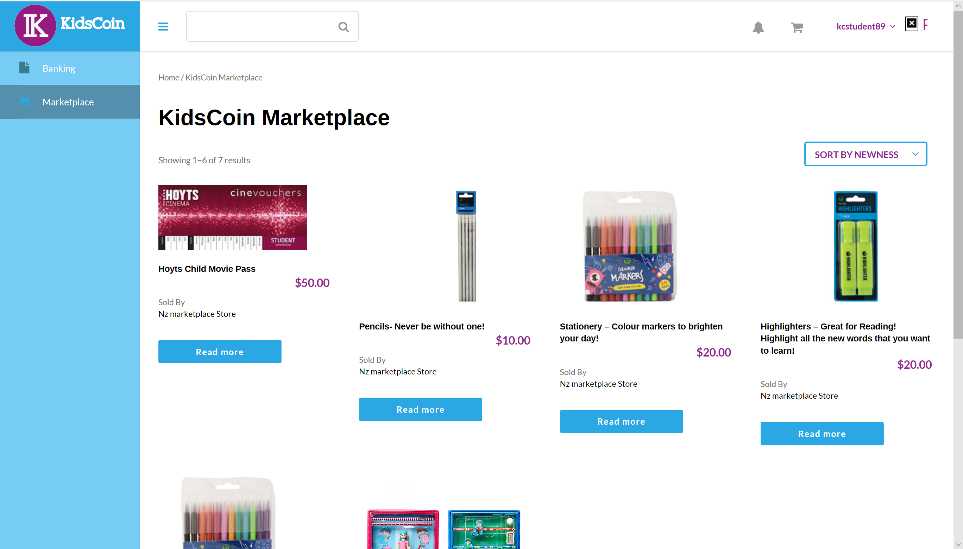

Slide 9
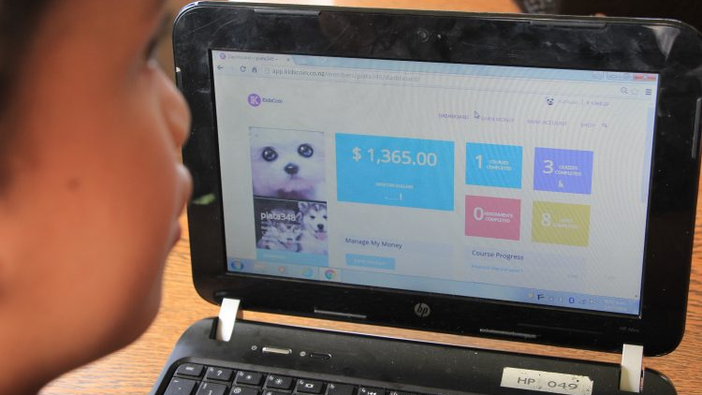
Key learnings from the classroom…

Slide 10
Let me introduce you to… Hine Toa

Slide 11
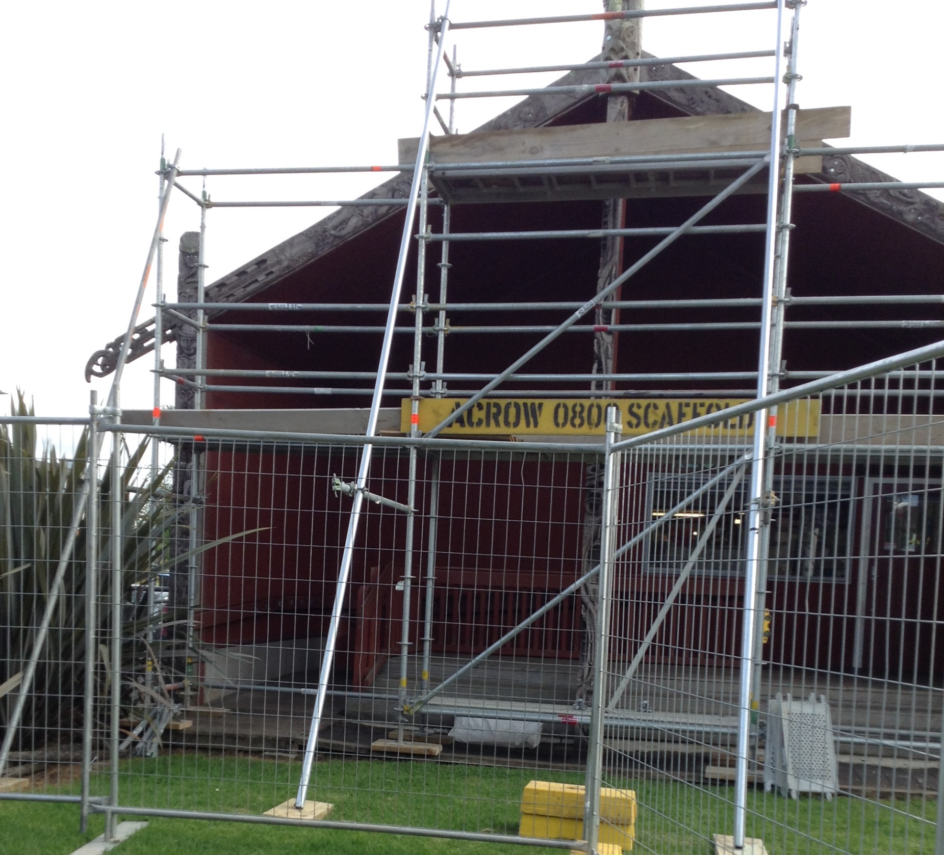
“We are asking for your permission to go to the B.O.T, meeting . so we can ask the Board of Trustes to redo our whare. “ “We would like to speak at the meeting to see if there might be a budget for this project.”

Slide 12
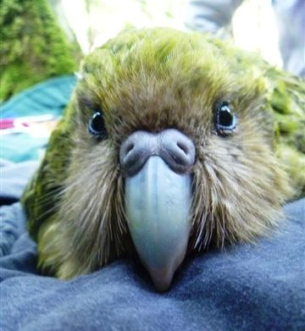
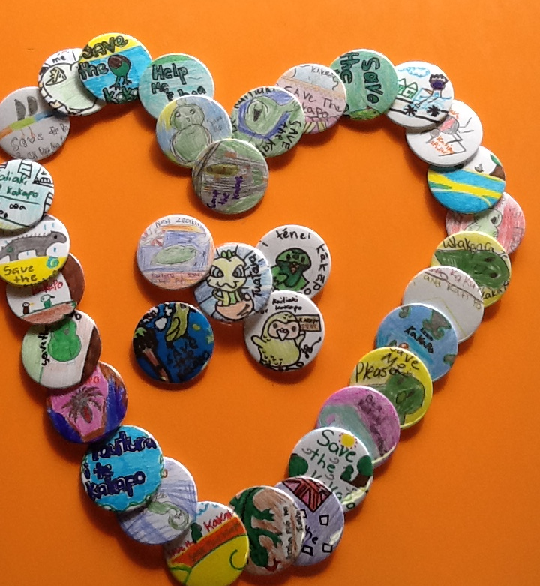

Slide 13
i have sent all the links to every one you will need to pay me 100 kidscoin dollars and i have also payed 88 dollars for my tax
i would also like to buy some noodles for friday just send me the price and i can send it to you and all the other kids money for the cooking and then i will sent it to you.
so they can still pay me and i will just give you the money and i will tell you how much you need to pay me.
Thanks
Māori boy, 8 years old

Slide 14
Family Workshops
Vendor Marketplace
Vendors
Parents
Educators
KidsCoin Kids
Education Marketplace
Digital Products
Connection and Community

Slide 15
“Innovation is taking two things that already exist and putting them together in a new way”
Tom Freston
CEO of MTV Networks and Nickelodean

